Slide 1
Recurrences
Chaklam Silpasuwanchai

Slide 2
We called merge sort
Recursive function
factorial
if n == 1 return 1
return factorial(n-1) * n
Plan for today
Algorithm: maximum subarray problem
How to estimate the time of recursive function?

Slide 3
Readings
Chapter 4, Divide and Conquer, Cormen et al. (2009). Introduction to Algorithms, Third Edition (3rd ed.). The MIT Press.
Chapter 4-10, Divide and Conquer, Skiena, S. S. (2008). The Algorithm Design Manual, Second Edition (2nd ed.). Springer Science & Business Media.

Slide 4
Outline
Merge Sort recurrence
Maximum Subarray recurrence
Solving Recurrences

Slide 5
Merge Sort recurrence

Slide 6

Recurrence equation
T(n) - running time
D(n) - dividing time
C(n) - combining time
a - number of subproblems
n/b - size of each subproblem
Notes:
Both are theta of n

Slide 7

Recurrent equation of Merge Sort
D(n) = 𝚯(1) because computing the middle takes constant time
C(n) = 𝚯(n) because merge is of n order
a = 2 because we recursively solve two subproblems
b = 2 because each of the subproblems are of size n/2
But then….what is T(n/2) ? or, how to solve this recurrence equation?
Notes:
Both are theta of n

Slide 8
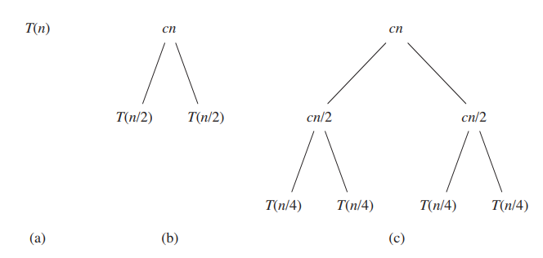
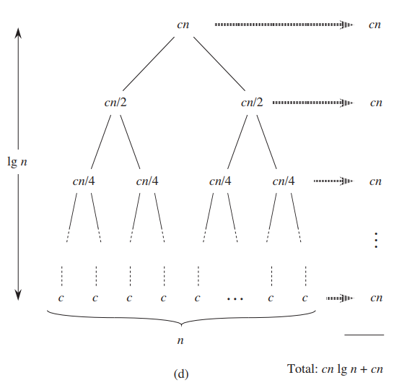
Solving using tree
Using a simple recursive tree can solve this problem. The top level has total cost cn, the next level has total cost c (n/2) + c (n/2). The next level is c (n/4) + c (n/4) + c (n/4) + c (n/4), and so on.
Since the total level (or the height) is log n + 1, the worst running time of merge sort is cn (log n + 1). Ignoring the low-order term and constant c gives the result of 𝚯 (n log n)
Notice that we assume n is an exact power of 2. This is fine because we are doing an upper bound estimation
Notes:
Both are theta of n

Slide 9
Solving using substitution
After recursion tree gives us a good intuition on running time, we can further verify the bound using substitution method through mathematical induction
Guess: T(n) = O(n lg n)
Assume: T(n) ≤ c * n lg n
T(n) = 2 * T(n/2) + c * n
T(n) ≤ 2 * c * n/2 lg n/2 + c * n
T(n) ≤ c*n lg n/2 + c * n
T(n) ≤ c*n lg n - c*n lg 2 + c*n
T(n) ≤ c * n lg n - c*n + c*n
T(n) ≤ c * n lg n - (c*n - c*n)
We need to find c*n - c*n ≥ 0. Answer is it works for any combinations of c and n.
Notes:
Both are theta of n

Slide 10


Merge sort complexity
Thus worst running time of MERGE-SORT

Slide 11

Technicalities in recurrences
In practice, we neglect some details when solving recurrences. For example, when solving MERGE SORT and n is odd, the size is not exactly n/2, instead it is
We usually omit these details including floors, ceilings, and boundary conditions as we know that their impact is a constant and omitting will make solving recurrences much simpler

Slide 12
Maximum subarray recurrence

Slide 13
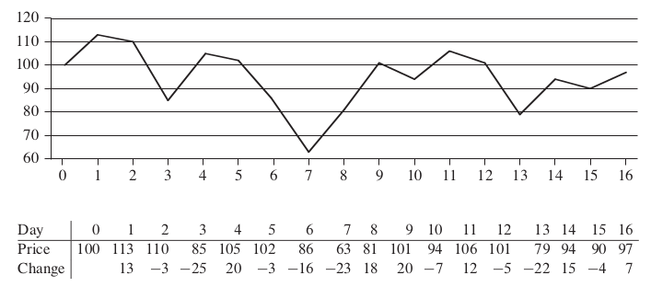
The maximum-subarray problem
Your goal is to maximize your profit

Slide 14
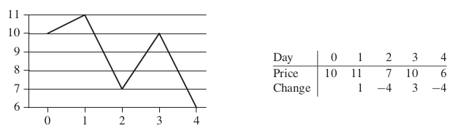
The maximum-subarray problem
Buying at the lowest or selling at highest won’t yield the maximum profit
Here, take another example, where maximum profit of $3 can be bought after day 2 and selling after day 3. Neither day was lowest or highest price

Slide 15

The maximum-subarray problem
A brute force solution
We can easily brute-force and try every combinations
A period of n days has pairs of dates. Since is 𝚯(n²) , thus, the running time would be 𝛀(n²)

Slide 16
The maximum-subarray problem
A transformation
We could create an array containing the daily difference. Then we can find a contiguous subarray that has the maximum sum (also known as maximum subarray). For example, A[8..11] has the max of 43

Slide 17
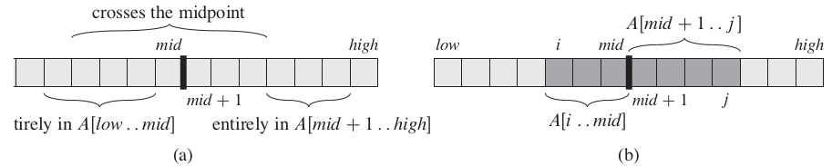
The maximum-subarray problem
A solution using divide-and-conquer
We can imagine splitting the array into subarrays such that our desired array A[i...j] of A[low...high] must lie in exactly one of the following places
Entirely in the subarray of A[low...mid] so low ≤ i ≤ j ≤ mid
Entirely in the subarray of A[mid + 1...high] so mid < i ≤ j ≤ high
Crossing the midpoint, so that low ≤ i ≤ mid < j ≤ high

Slide 18
In-Class Exercise
-5 | 1 | 2 | 9 | -5 | 8

Slide 19
In-Class Exercise
2 | -1 | 4 | -5 | 4 | 3

Slide 20
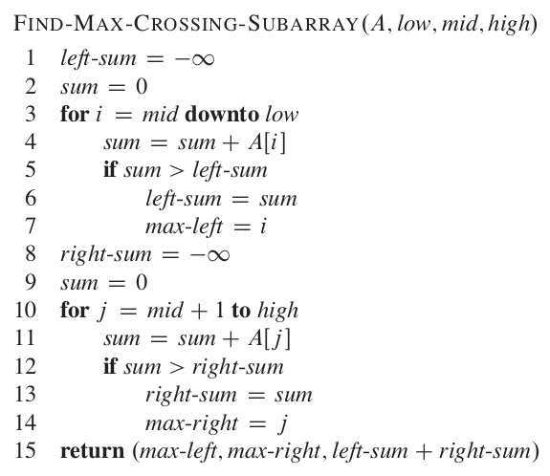
The maximum-subarray problem
Takes mid - low + 1 times (index starts from 1, thus need + 1)
Takes high - mid times
Thus, running time is (mid - low + 1) + (high - mid) = high - low + 1 = n

Slide 21
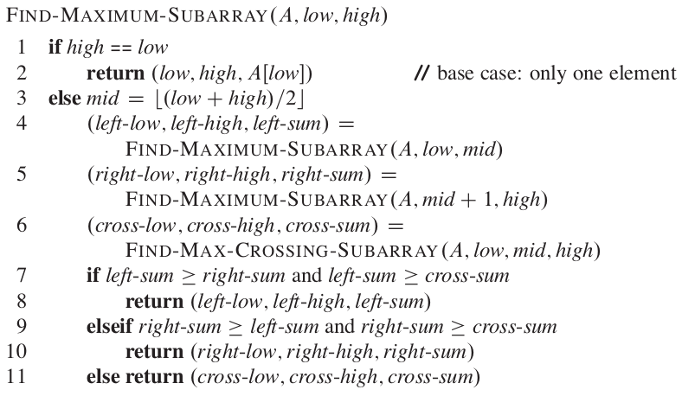
The maximum-subarray problem
Takes mid - low + 1 times
Takes high - mid times

Slide 22

Forming the equation
We make a simplifying assumption that the original problem size is a power of 2, so that all subproblem sizes are integers
We denote T(n) the running time
When n = 1, T(1) = Θ(1)
When n > 1, line 1 and 3 take constant time. Each of the subproblems solved in lines 4 and 5 is on a subarray of n/2 elements (thus T(n/2)). Because we have left and right arrays, thus 2T(n/2). Find crossing max takes Θ(n). Lines 7-11 takes only Θ(1). Thus

Slide 23

Same equation as merge sort!
Finally, to account when n = 1, T(n) is
As we can see, this recurrence is the same as merge sort and T(n) = Θ(n lg n)
Thus we see that divide-and-conquer is better than brute force which takes Θ(n²)

Slide 24
Solving recurrences

Slide 25
Solving recurrences
Recall three ways to solve recurrences
In the substitution method, we guess a bound and use mathematical induction to prove
In the recursion tree method, we use a tree to represent the costs and roughly make an estimates (later use substitution)
In the master theorem, under certain assumptions and of the known fact regarding recurrences, it uses a simple equation to solve

Slide 26
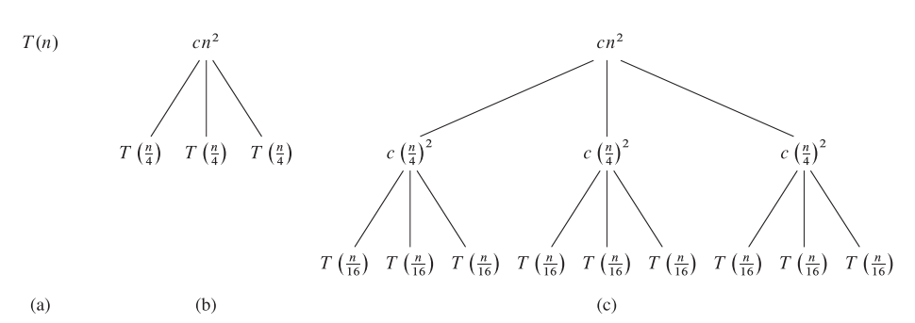
Recursion-tree method for solving recurrences

Slide 27
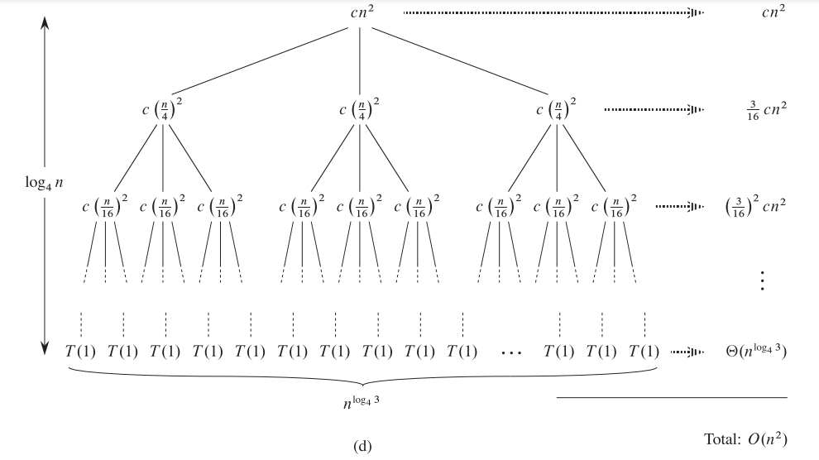
Recursion-tree method for solving recurrences
The problem size at depth i is n/4^{i}
The subproblem size hits n = 1 when n/4^{i} = 1, or i = log₄n. Thus the tree has log₄n levels
The cost of each level
Number of nodes at depth i is 3^{i}
Each node at depth i has a cost of c(n/4^{i})²
Total cost of all nodes at each depth is 3^{i} c(n/4^{i})²
The bottom level, at depth log₄n has 3^{log4n} (same as n^{log43}) nodes, each contributing cost of 1

Slide 28
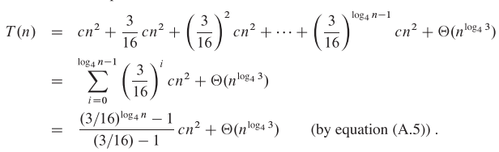
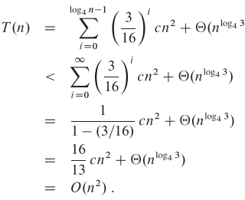

Recursion-tree method for solving recurrences
Sum up all the costs
We can use an infinite decreasing geometric series as an upper bound
Note (A.6):
As you can see, cn² dictates the total cost of the tree

Slide 29
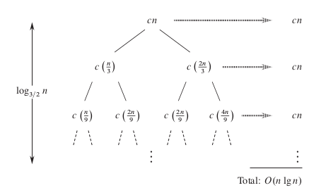
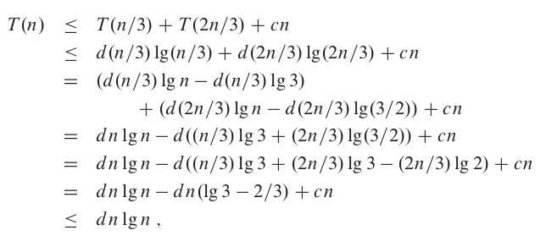
Recursion-tree method for solving recurrences
Consider
The longest path to a leaf is n → ⅔ n → (⅔)²n …. → 1
Since (⅔)^{k}n = 1, k = log_{3/2}n thus its height
Intuitively, we expect the solution to the recurrence to be at most the number of levels times the cost of each level, or O(cn log_{3/2}n) = O(nlgn)
However, each level is not exactly n.
Consider the cost of the leaves. If this is a complete binary tree of height log_{3/2}n, total cost of leaves is 2^{log3/2n} = n^{log3/22 .} Since log_{3/2}2 is greater than 1 but less than 2, we can say n lg n
But this is not a binary tree, thus the amount of leaves will be less. However, n lg n is a good upper bound

Slide 30

Exercise
CLRS 4.4-1 Use a recursion tree to determine a good asymptotic upper bound on the recurrence
Use the substitution method to verify your answer.

Slide 31
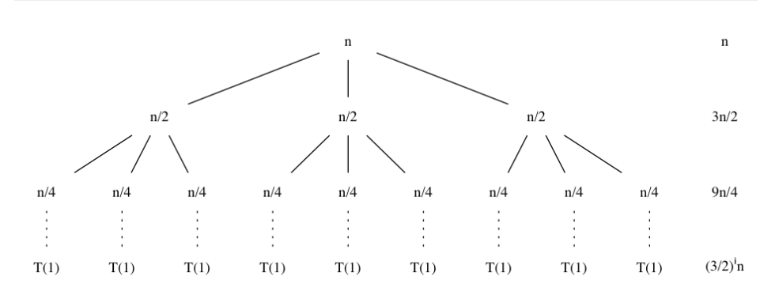
CLRS 4.4.1
The problem size at depth i is n/2^{i}
Thus, the subproblem size hits n = 1 when n/2^{i} = 1, or equivalently when i = log₂n. Thus the tree has log₂n + 1 levels
Each level has three times more nodes than the level above, thus number of nodes at depth i is 3i
The total cost of all nodes at each depth is 3^{i} c(n/2^{i}) = (3/2)^{i}n
The bottom level, at depth log₂n has 3^{log2n} (same as n^{log23}) leaves, each contributing cost of 1 = n^{log3} cost

Slide 32
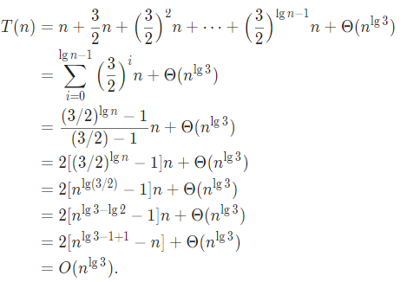

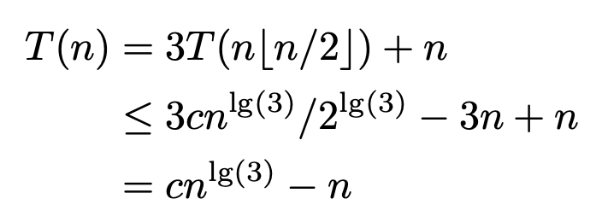
Sum up all the costs
Let’s use substitution. Let’s guess T(n) ≤ cn^{lg3} - 2n
Note (A.5):

Slide 33

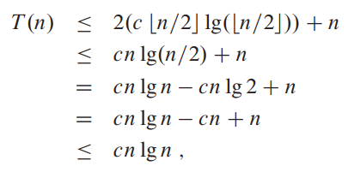
Substitution method
Suppose we guess that T(n) = O(n lg n)
Then the substitution method requires us to prove that T(n) ≤ cn lg n for some c > 0, thus substituting yields

Slide 34


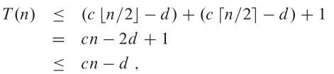
Substitution method
Sometimes, we might guess right but somehow the math fails. Being aware that we are working under the simplifications of complexity helps.
For example, consider
Our guess is T(n) = O(n). We thus require to prove that T(n) ≤ cn for some c > 0
We substitute and get
Although we did not get the exact math, it is okay to subtract the lower-order term (i.e., 1). We can make a new guess T(n) ≤ cn - d
when d >=1, cn-d >= cn-2d + 1, thus our proof is right

Slide 35
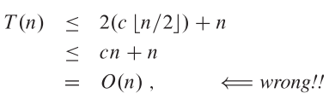
Substitution method
Avoiding pitfalls
Guess T(n) = O(n), thus need to prove T(n) ≤ cn
The error is that we did not prove the exact form of the inductive hypothesis, thus we need to prove exactly T(n) ≤ cn when we want to show T(n) = O(n)

Slide 36
Exercises
CLRS 4.3-1 Show that the solution of T(n) = T(n-1) + n is O(n²)

Slide 37
Exercises
CLRS 4.3-2 Show that the solution of T(n) = T(⌈n/2⌉) + 1 is O(lg n)

Slide 38

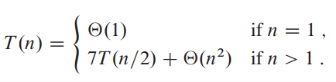
Master method for solving recurrences
The master method provides a “cookbook”method for solving recurrences of the form:
where a ≥ 1 and b > 1 and f(n) is an asymptotically positive function
This equation describes an algorithm that divides a problem of size n into a subproblems, each of size n/b, where a and b are positive constants
The a subproblems are solved recursively, each in time T(n/b)
The function f(n) describes the cost of dividing and combining the results of the subproblems
Usually convenient to omit floor and ceiling functions
For example
this equation shares the form, with a = 7, b = 2 and f(n) = n²

Slide 39
Three cases
Case 1: The top node dominates
Case 2: The bottom node dominates
Case 3: The top = bottom, so width * height

Slide 40
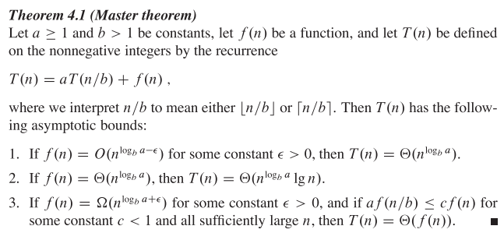
Master method for solving recurrences
a is number of subproblems
b is the size of the subproblem
f(n) ≤ n^{logba}
f(n) = n^{logba}
f(n) ≥ n^{logba}

Slide 41
Master method for solving recurrences
Some cautions:
In first case, f(n) should be polynomially smaller by a factor of n^{ε} where ε is constant greater than 0, that is f(n)/n^{logba} = n^{ε}
In third case, f(n) should be polynomially larger by a factor of n^{ε} where ε is constant greater than 0

Slide 42



Master method for solving recurrences
First example, consider
We have a = 9, b = 3, f(n) = n, thus we have that n^{logba} = n^{log39}, and thus = n². Since f(n) = O ( n^{log39 - 𝝐} ), where 𝝐 = 1, we can apply case 1 of master theorem and conclude that T(n) = Θ(n²)
Now consider
We have a = 1, b = 3/2, f(n) = 1, thus we have that n^{logba} = n^{log3/21} = n⁰ = 1 Case 2 applies, since f(n) = Θ( n^{logba} ) = Θ(1)
Thus the solution is T(n) = Θ(log n)
For the recurrence
We have a = 3, b = 4, f(n) = n lg n, thus n^{logba} = n^{log43} = O(n^{0.793})
Since f(n) =Ω( n^{log43 + ε}) where ε ≈ 0.2 , case 3 applies
For sufficiently large n, we have that a f(n/b) ≤ c f(n) = 3 (n/4)lg(n/4) ≤ (¾) n log n for c = ¾
The solution is thus T(n) = Θ(n lg n)

Slide 43


Master method for solving recurrences
For the recurrence
We have a = 2, b = 2, f(n) = n lg n, thus n^{logba} = n
Master theorem fails to apply. Case 3 cannot apply because the ratio f(n)/n^{logba} = (n lg n)/n = lg n which is asymptotically less than n^{ε} for any positive constant ε
For
We have a = 2, b = 2, f(n) = Θ(n), thus n^{log22} = n
Case 2 applies, since f(n) = Θ(n)
Thus T(n) = Θ (n lg n)
For
We have a =7, b = 2, f(n) = Θ(n²), thus n^{log27}
2.80 < lg 7 < 2.81, thus f(n) = Θ(n^{lg 7 - ε}) for ε = 0.8
Case 1 applies thus T(n) = Θ (n^{lg 7})

Slide 44
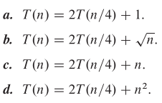
Exercise
CLRS 4.5-1 Use the master method to give tight asymptotic bounds for the following recurrences

Slide 45
Programming Assignment
Implement maximum subarray and measure its complexity

